Slide 1
Calibration-Related Tickets Management

Slide 2

New Suggestions to reduce ticket escalations
This brief presents suggestions for consideration into current troubleshooting guide to reduce number of tickets escalated to the Calibration Team.
These suggestions are as a result of the Calibration Team’s experience and encounters during our operations
Also, nature of tickets which require escalation to the Team is listed for clarity going forwards

Slide 3
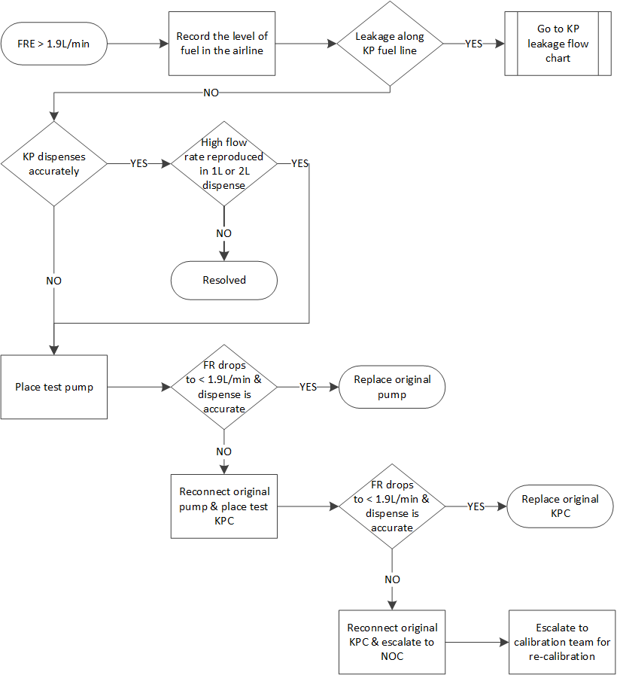
Suggestion 1: Flow rate error (FRE) > 1.9L/min
Flowmeter crimping intact (Esp GND)
No
Escalate to NOC
Checks to do on the FLM connector
Visual - check for looseness especially on the GND (sheath).
During a dispense, push the sheath connector in and out and observe any changes in flow rates

Slide 4
Suggestion 2: Abnormally low flow rates vs TL
Def Abnormally low flow rate:
Flow rate that is too low for the current tank level
Examples;
1.1L/min at 306L
1.0L/min at 280L
0.9L/min at 100L
Discovered additional root causes;
Faulty DV.
Flow rate before and after the DV should be obtained and a drop calculated. If the drop is more than significantly large
Clogged pump filter - Cause error 092

Slide 5
Suggestion 3: Volumetric Measuring Equipment
Equip the maintenance team/or selected members with volumetric measurement skills and tools to respond to KP dispense inaccuracy tickets.
This will improve the accuracy of ticket outcomes at the maintenance team level and OLA performance.
This will reduce the escalated tickets workload on the Calibration Team as majority of the KPs are found to be accurate upon verification
Training can be done over the weekends/on local arrangements
Tools required to empty and accurately measure canister contents include;
A smart valve for emptying the canister.
A 1L and 2L Class B plastic measuring cylinder.
A measuring cylinder leveling platform.

Slide 6
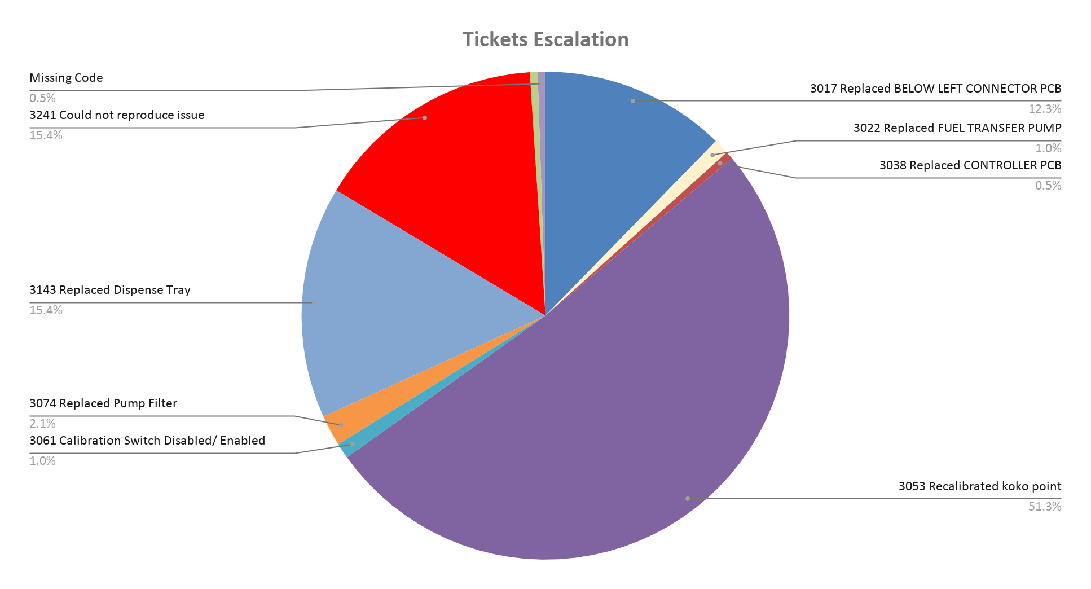
Last 6 Month Calibration Tickets

Slide 7
Action Points
WorkFlow - Define the minimum threshold or bare minimum of the tickets that need to be escalated to Calibration Team (Agreed with Duke, Steve, Henry and Collins)
Calibration Training - Maintenance team to be trained on calibration process, this will result on the quality of the ticket escalated to Calibration. (To Plan with Collins and Steve)
Tools Purchase - Need to Purchase Crimping tools and class B measuring Cylinder for the calibration and maintenance Team. (Review Quantity needed)
Leveling Platform - Need to purchase Timber and bolts to Assemble more Measuring cylinder Levelling Platform. (Review Quantity needed)

Slide 8
Suggestion 4: Error Codes
451 - Calibration switch was in a write state when the controller started.
Check connection between calibration module and KPC
Swap cable
Check integrity of the cable (proper crimping)
452 - One or more of the calibration string parameters is/are not valid.
-Restart the KP

Slide 9
Tickets To Escalate
Escalation to Calibration Team
Involves high costs (SG and or W&M Technician Charges) as the team needs the services of the above when visiting a KP for ticket resolution due to the need to break/re-seal any point.
The team is currently thinly spread across more urgent activities, including Network-wide KP upgrades to 12V BL PCBs and W&M KP sealing
Tickets to be escalated after thorough investigation and due diligence;
Involving breaking of the flowmeter connector seal to swap it or the BL PCB.
Re-crimping the flowmeter connector cable.
Involving breaking the calibration module cover seal for recalibration.

Slide 10

Thank you

